Slide 1
FRITO LAY: Employee Attrition
Katherine Nguyen
Brought to you by DDSAnalytics
Notes:
Hello! My name is Katherine Nguyen and I am representing DDS Analytics today to investigate employee attrition at Frito Lay.

Slide 2


BACKGROUND
Who Are We?
DDSAnalytics - leveraging data science to provide talent management solutions for Fortune 100 companies
DDS
Purpose:
Optimize talent management at Frito Lay by identifying current attrition trends and predicting employee turnover using existing employee data
Notes:
As part of DDSAnalytics I will be utilizing data science to understand causes behind attrition and predict employee turnover at Frito Lay

Slide 3
OBJECTIVES
Identify the top 3 factors contributing to turnover
Highlight specific job role trends that may exist in the data set
Predict attrition based on Naïve Bayes model
Notes:
Our objectives today are to
Identify the top 3 factors that are affecting turnover
Investigate specific job role trends, if any
Predict employee attrition by implementing the Naïve Bayes model

Slide 4
EXISTING DATA
870 anonymously surveyed employees
35 survey questions covering topics such as education/career background, demographics, job satisfaction, training time, etc.
Limited to jobs in Sales, Research & Development, and Human Resources
Notes:
For today’s study, we used an existing data set that anonymously surveyed 870 employees covering 35 various categories, and derived from jobs in sales, r&d, and HR

Slide 5
METHODOLOGY
Removed missing data
Identified quantitative vs categorical data
Explored variables explaining attrition
Analyzed robustness on accuracy, sensitivity, specificity, and F1
Developed a model to predict for attrition
Notes:
In terms of the methodology followed, I initially cleaned up the data by removing missing data (none) and disregarding variables I felt were unnecessary, separated the data by numeric and categorical variables, completed an eda on the variables with respect to attrition, developed the optimal model to predict attrition, and analyzed the robustness of the model to predict attrition on a new employee data set.
No missing data
Disregarded unnecessary variables: ID, employee number, over 18, and standard hours

Slide 6
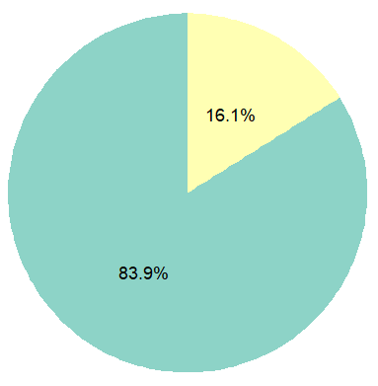
Data Set: Attrition Rate
Attrition Rate
As seen in the pie chart, there is a 16.1% rate of attrition, compared to retention
 | No
 | Yes
Notes:
So, first things first, I stepped back and looked at the big picture: what is the rate of attrition on the data set overall? And, as you can see in the pie chart, there is a 16.1% rate of attrition, which we are trying to minimize.

Slide 7
EDA: Top Contributing Factors

Slide 8
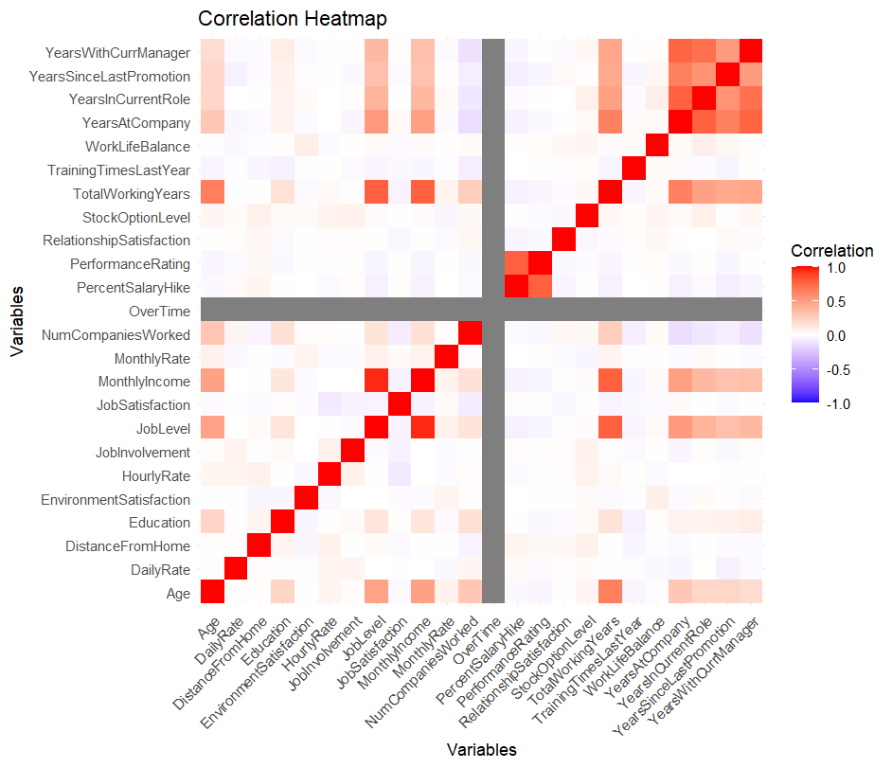
Heat Map: Big Picture Correlation
Factors
Factors
Notes:
Again, at a high level glance at the data, I wanted to investigate whether the various factors were correlated in any way. I will zoom in to show

Slide 9
Heat Map: Big Picture Correlation
YearsWithCurrManager
YearsSinceLastPromotion
YearsInCurrentRole
YearsAtCompany
TotalWorkingYears
High rate of correlation between certain variables
Job Level
Monthly Income
YearsWithCurrManager
YearsAtCompany
YearsInCurrentRole
YearsSinceLastPromotion
Notes:
I will zoom in to show areas that I found interesting and showed a strong positive correlation, as indicated by the stars. In blue, you can see the factors I saw had high correlation between each other and a lot of it had to do with age/length of experience.

Slide 10
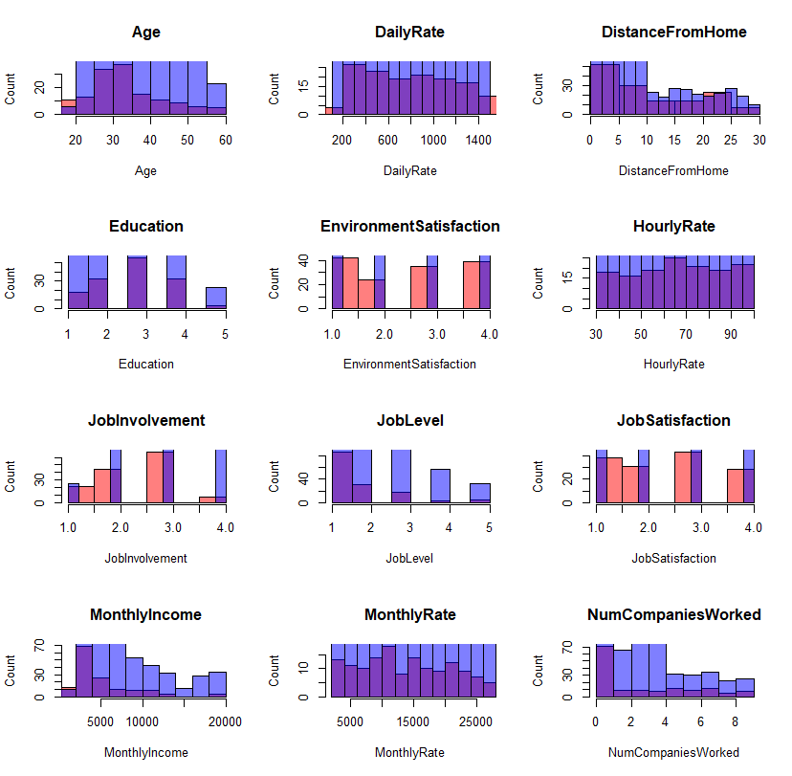
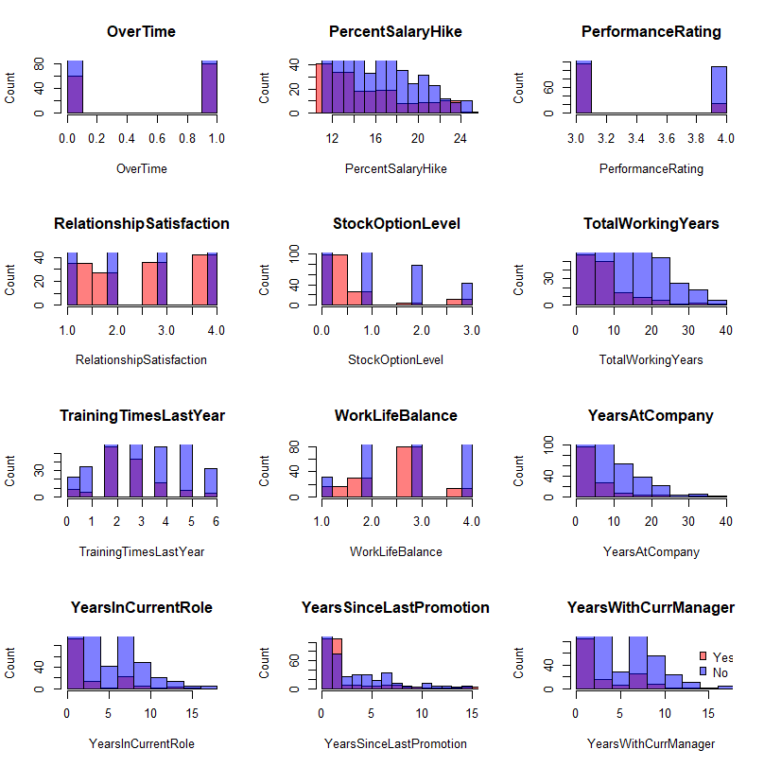
Big Picture: Correlation
Notes:
Next, I broke down the data into individual plots to see the effect of attrition on each variable. I noted the factors that had skewed attrited data to determine the top factors.

Slide 11
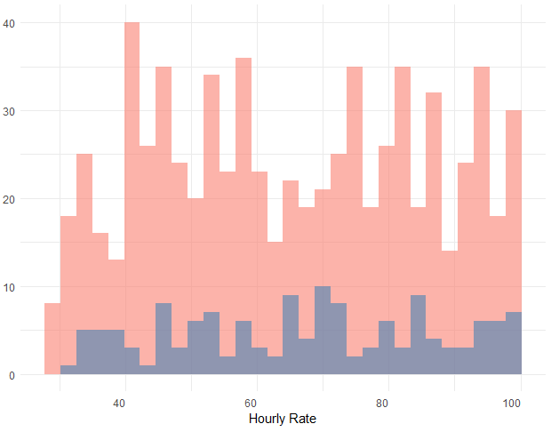
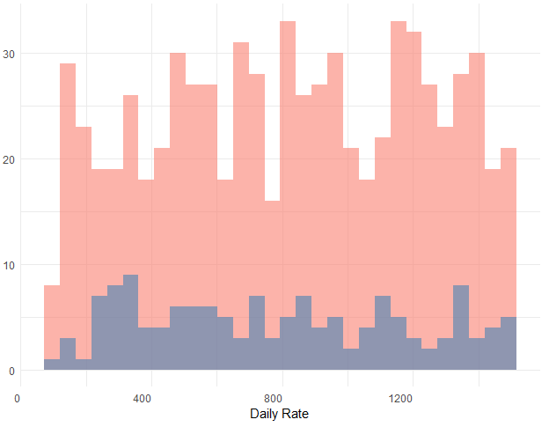
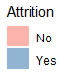
Big Picture: Correlation
Attrition vs. Income
Count
Count
Hourly Rate*
Daily Rate*
Notes:
One of the first trends I saw was with income. I noticed that there were four different categories for income. All have similar, no trend in correlation, drop the variables

Slide 12
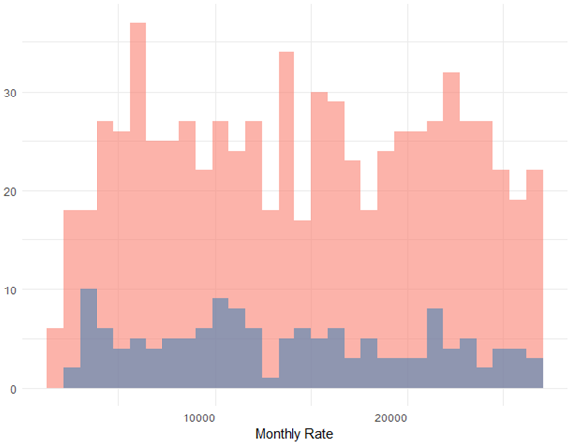
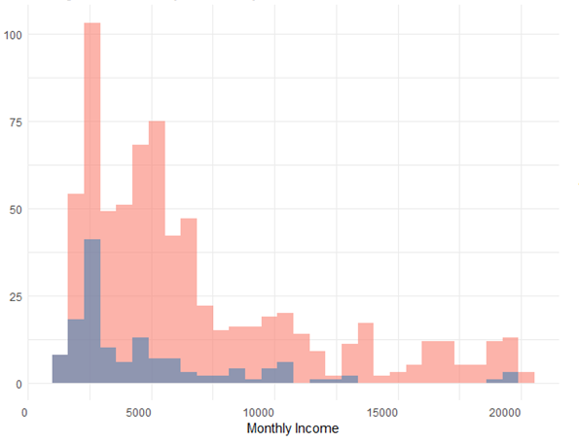
Big Picture: Correlation
Attrition vs. Income
Count
Count
Monthly Rate*
Monthly Income
No significant trend seen in the hourly/daily/monthly rates
Notes:
All have similar, no trend in correlation, drop the variables except for monthly income which appears to have a larger difference in those who were attrited at lower levels of income.

Slide 13
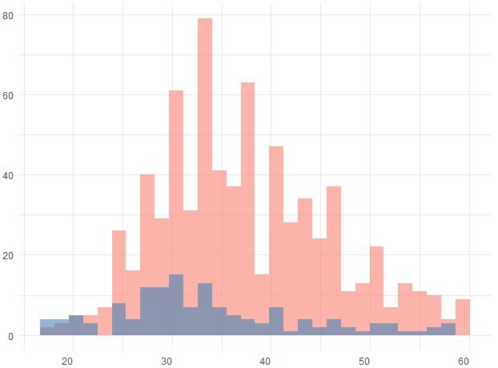
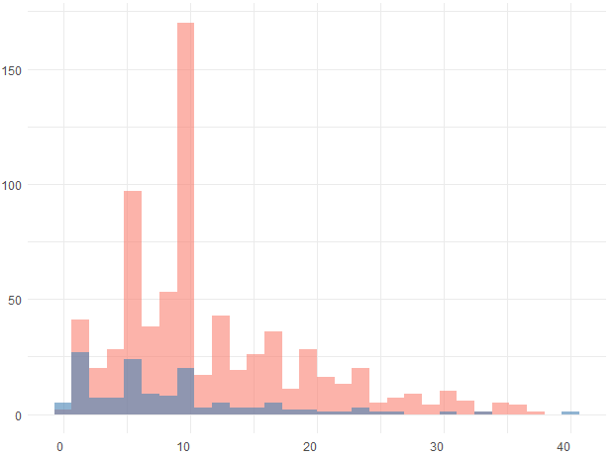
Big Picture: Correlation
Attrition vs. Age/Career Length
Count
Count
Age
Total Working Years
Notes:
Then, as I alluded to previously, I looked into the correlation between factors related to age and career length. with younger employees with higher attrition

Slide 14
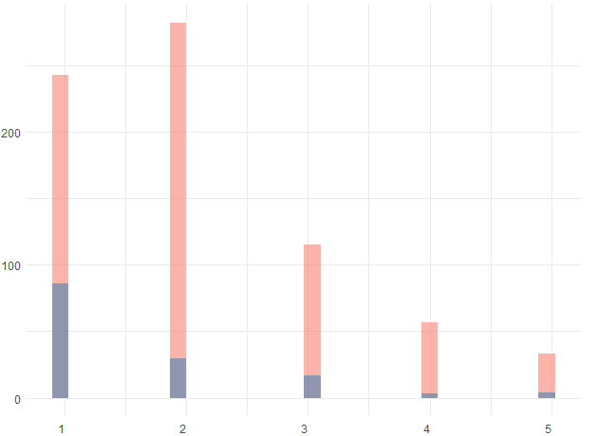
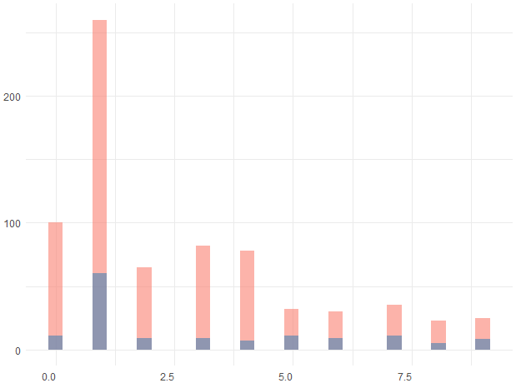
Big Picture: Correlation
Attrition vs. Age/Career Length
Count
Count
Job Level
# of Companies Worked
Correlation with younger employees with higher attrition rate
Notes:
Correlation with younger employees with higher attrition

Slide 15
Big Picture: Correlation
Attrition vs. Age
Attrition vs. Monthly Income
Count
Count
Age
Monthly Income
Factors that highly contribute to attrition rate
Notes:
As a result, I identified age and monthly income as top factors that contribute to attrition.

Slide 16
Effects of Job Role/Department
Notes:
Next, I looed into the effects of specific job roles between departments

Slide 17
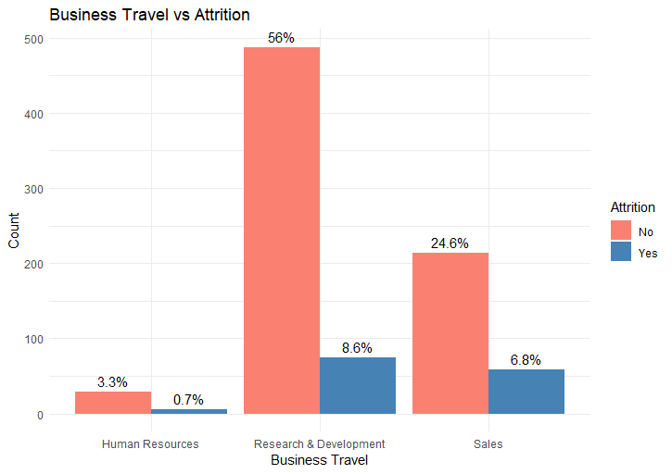
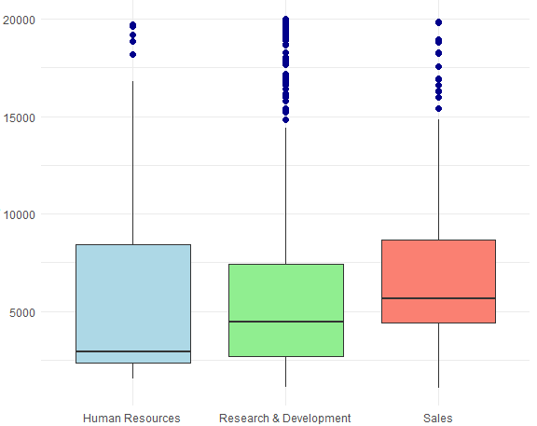
Trends by Department
Attrition Rates
Monthly Income
Count
HR
R&D
Sales
HR
R&D
Sales
Notes:
I broke the attrition rates down to the departments and pulled monthly income to do a comparison. It was interesting to see that although sales had the greatest median monthly income, still had a higher attrition rate

Slide 18
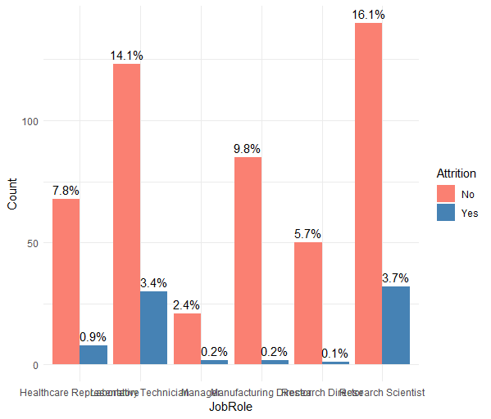
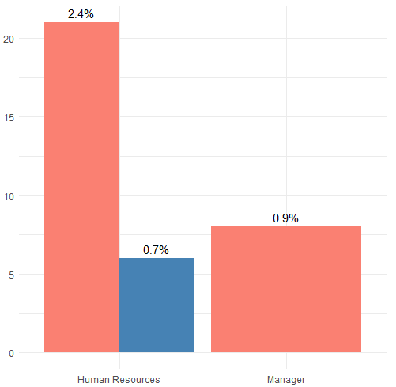
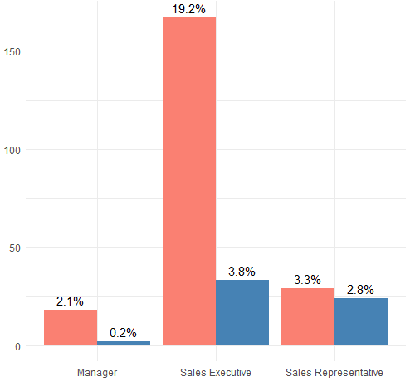
Trends by Department
Sales
Human Resources
Research & Development
Count
Count
Count
Manager
Sales Exec
Sales Rep
HR
Manager
Healthcare Rep
Lab Tech
Manager
Manuf. Director
Research Director
Research Scientist
Sales Executive and Research Scientist had the highest rates of attrition
Notes:
Then I broke down attrition data even further to see the trends at each job role. Sales Exec and Research Scientist had the highest rate of attrition among all the job roles within the data set. It was easy to conclude that the job roles also have a role in the attrition rate.

Slide 19
Prediction Modeling
via Naïve Bayes
Notes:
After identifying the top factors, I moved onto using the Naïve Bayes model to predict attrition as it is a simple and effective way to make predictions based on probabilities.

Slide 20
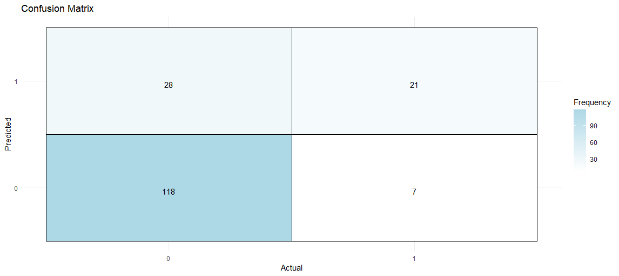
Prediction Results
Yes
28
21
Predicted
Correctly predicted instances
Incorrectly predicted instances
No
118
7
No
Yes
Actual
 | Accuracy | Sensitivity | Specificity | F1
Results | 79.9% | 80.8% | 75.0% | 87.1%
Notes:
As a result, my model was able to predict with 79.9% accuracy. Accuracy (79.9%):
did well overall at predicting whether an employee would stay or leave.
Sensitivity (true positive):
80.8%, Correctly identified those who actually left the company (21 (true positive) vs 7 (false negative)), good
Specificity:
75%, Incorrectly predicted employees would leave than when they actually stayed (118 (true negative) vs 28 (false positive))
F1:
87.1% Good balance between precision and recall, suggesting it performed well in identifying, yes employees attritted, without too many false positives/negatives

Slide 21
Next Steps
Notes:
Used the Naïve Bayes model as it is a simple and effective way to make predictions based on probabilities.

Slide 22

Next Steps
Reduce attrition
Focus on top 3 factors identified:
Age
Monthly Income
Job Roles (i.e., Sales Executive, Research Scientist)
Utilize the proposed model to predict attrition
Notes:
Reduce attrition: improve retention, retain talent, further growth of company
In particular, important to focus on retaining young talent, offering competitive pay, work out kinks that may be present in those job roles

Slide 23
Thank you!
Please do not hesitate to contact me:
Katherine Nguyen | nguyenkh@smu.edu
Notes:
Thank you for listening to my analysis on employee attrition! IF you have any questions, please contact me! My information is listed right here on this slide.

